Slide 1






ESG IMPACT
REPORT
2025
YOUR PACKAGING SOLUTIONS PROVIDER

Slide 2




TABLE OF
CONTENTS
Introduction
01
Employee Engagement
07
Our Mission
02
Celebrating People
08
Our Values
03
Volunteering
09
ESG Achievements 2024
04
Charity
10
Supply Chain
05
Accreditations
11
Renewable Energy
06
Social
12
The Future
13

Slide 3
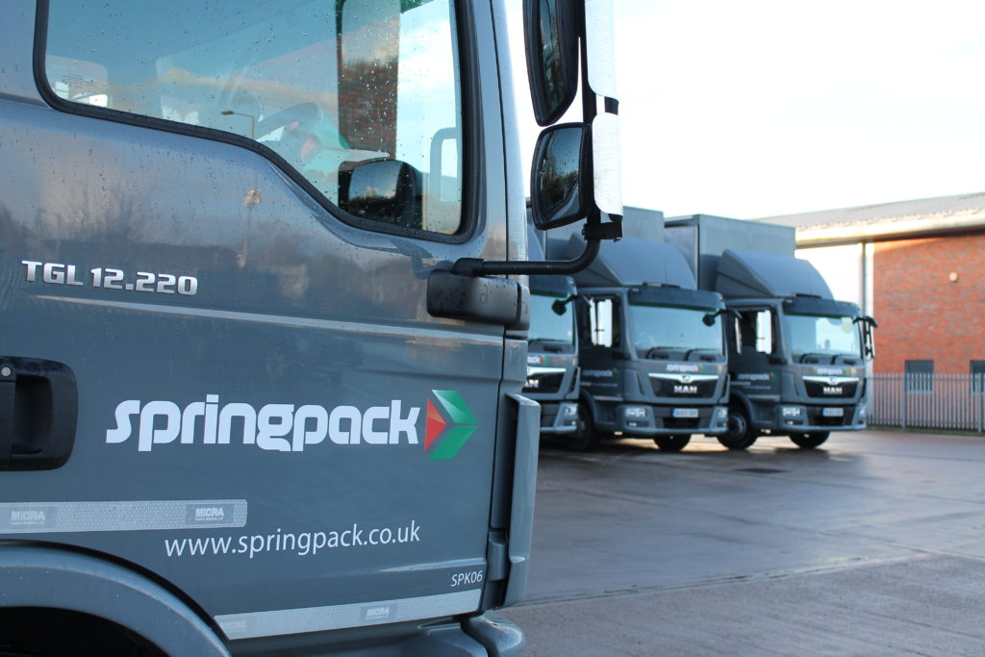


INTRODUCTION
01
We are Springpack, a leading provider of packaging solutions for fulfilment operations across the UK.
At Springpack, we thrive in an environment of creativity and innovation. Our unwavering dedication to our mission is evident in our relentless pursuit of innovative excellence, inspiring our clients with tailor-made packaging solutions that deliver unmatched brand experiences loved by consumers.
Springpack stands out as a prominent supplier of packaging solutions for fulfilment operations. We are deeply committed to delivering top-tier services and assisting our clients in crafting distinct and memorable brand experiences.

Slide 4



OUR MISSION
02
OVERVIEW
Springpack is a UK packaging company delivering sustainable solutions that empower customers. We prioritise exceptional service, building strong relationships and developing innovative packaging solutions tailored to unique needs.
VISION
At Springpack our vision is clear, to be the most sustainable environmentally friendly service driven packaging company.
SUSTAINABILITY
Sustainability drives us, from eco-friendly materials to reusable practices minimising waste and emissions. As a family-run business, we've grown from humble beginnings to industry forerunners.
Our passion lies in making a positive impact in our community and the lives of customers, employees, and stakeholders through outstanding service that exceeds expectations.
PASSION

Slide 5







OUR VALUES
03
BE COURAGEOUS
BE EMPOWERED
BE AGILE
ACT SUSTAINABLY
HAVE INTEGRITY
BE ACCOUNTABLE

Slide 6











ESG ACHIEVEMENTS 2024
04
OVER 90% LOCALLY EMPLOYED TEAM
OVER 220
TRAINING HOURS COMPLETED
OVER £150,000 IN CHARITABLE DONATIONS
6% CO2 REDUCTION IN CAR FLEET
INCREASED RECYCLED CONTENT OF PLASTIC PRODUCTS
11% DECREASE IN CO2 SCOPE
1 & 2
ONLY ENERGY EFFICIENT LIGHTING USED ACROSS ENTIRE FACILITY
OVER 70 HOURS OF VOLUNTEERING
33% INCREASE IN FULLY ELECTRIC VEHICLE FLEET
FOC ONSITE ELECTRIC VEHICLE CHARGING
OVER 600
HOURS
11% CO2 REDUCTION IN HGV FLEET
0% WASTE TO LANDFILL
EMPLOYEE WELLBEING PROGRAMME

Slide 7
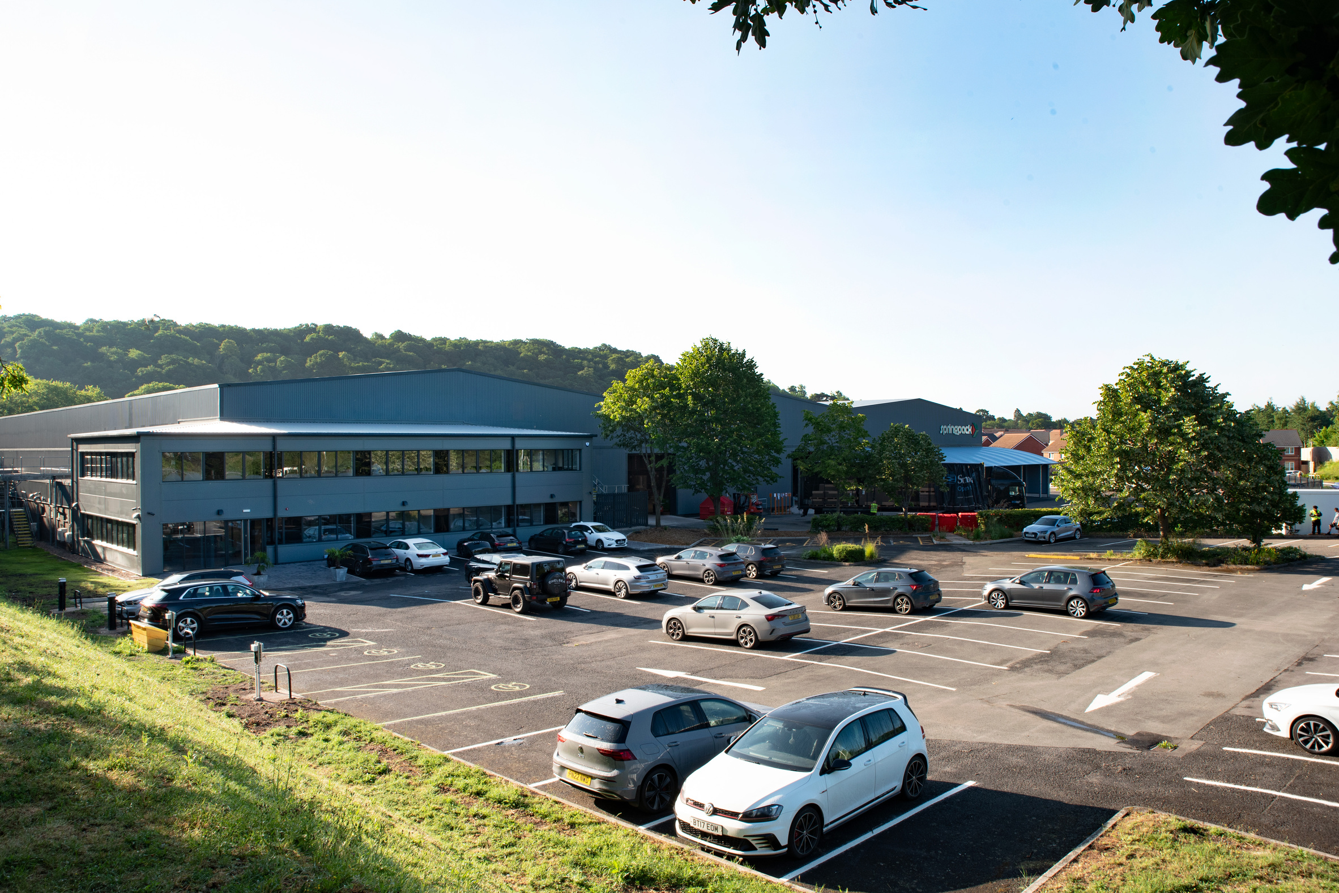



SUPPLY CHAIN
05
At Springpack, sustainability isn't just a buzzword – it's our guiding principle.
We regularly visit and audit all of our suppliers in our supply chains to ensure they follow eco-friendly practices and enhance suitability at every step.
To ensure that changes are continuous and made for the better, key suppliers have agreements in place, creating a more robust and eco-sustainable supply chain outlook.
Smaller suppliers are always treated as fairly as the larger ones. To enable growth across our supply chain, we offer preferential payment terms, which ensures both commitment and stability.
From sourcing materials responsibly to optimising transportation routes for efficiency, we're reducing our carbon footprint while maximising our impact. Join us on the journey towards a greener future, where every package delivered is a testament to our commitment to the planet.

Slide 8


RENEWABLE ENERGY
06
Springpacks electricity is backed by REGOs from natural energy sources such as solar, wind & hydro

Slide 9

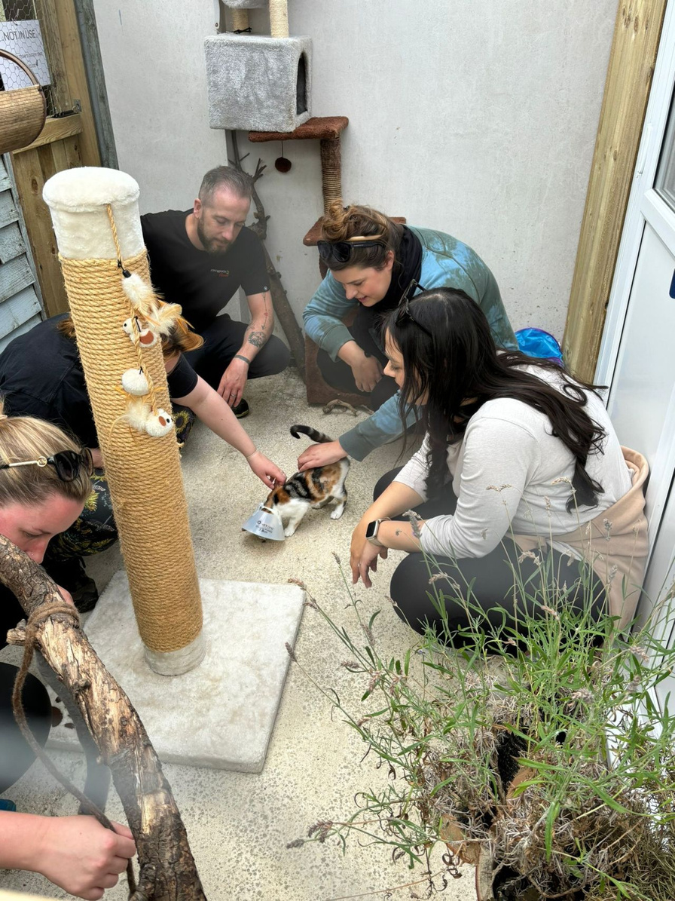
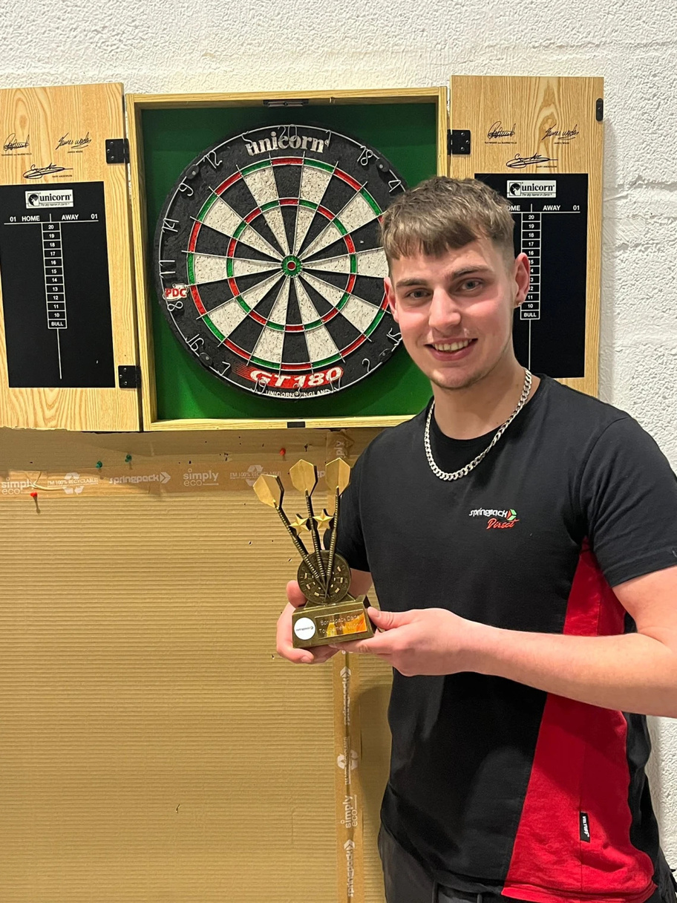
07
EMPLOYEE ENGAGEMENT

Slide 10
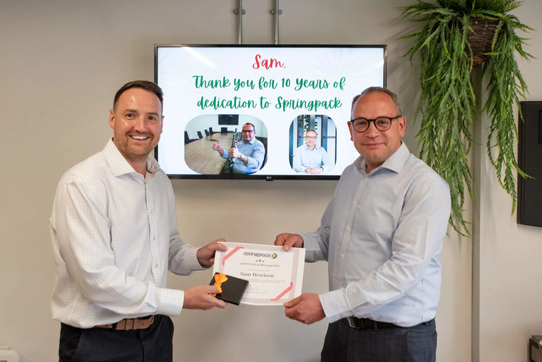
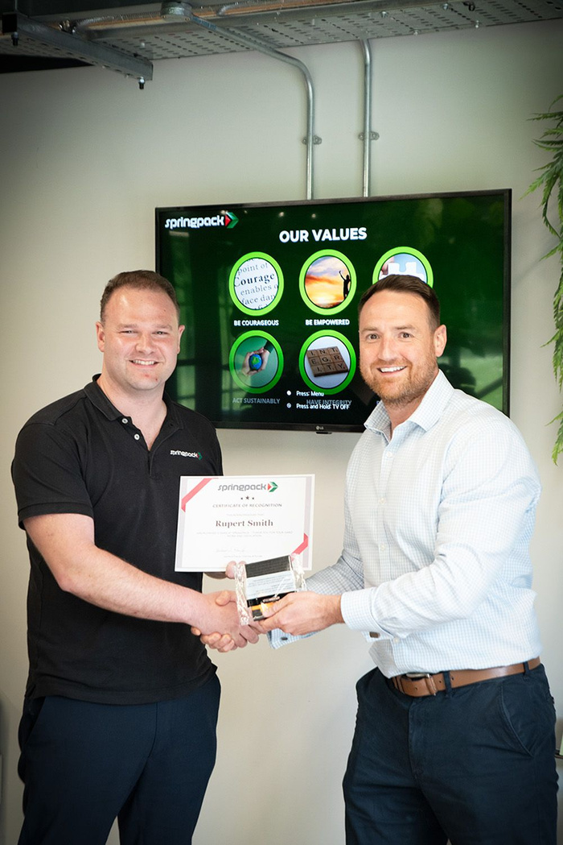

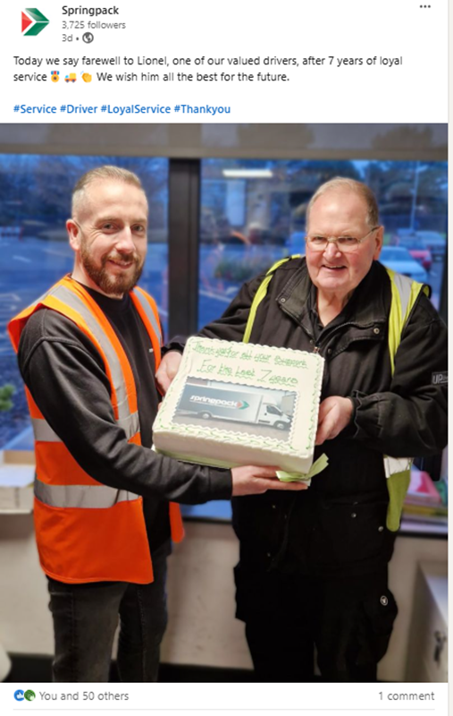
CELEBRATING PEOPLE
08
  7 OVER 5 YEAR ANNIVERSARY AWARDS
  4 RETIREMENTS WITH OVER 70 YEARS COMBINED SERVICE
AWARDED ONE OF THE BEST PLACES TO WORK FROM THE SUNDAY TIMES

Slide 11
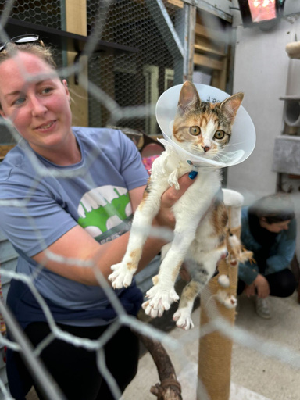
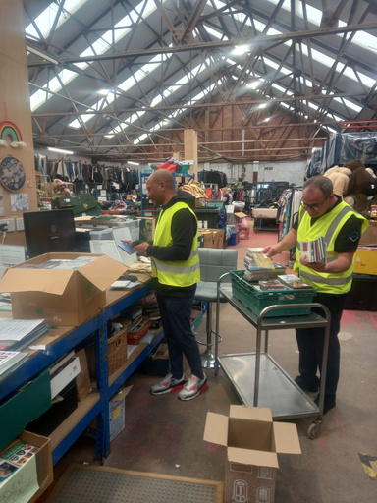
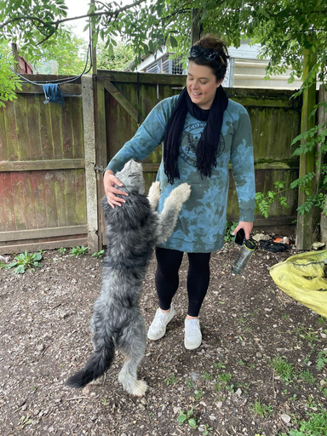
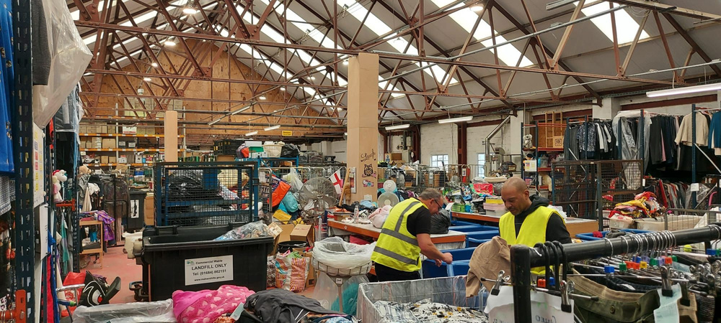
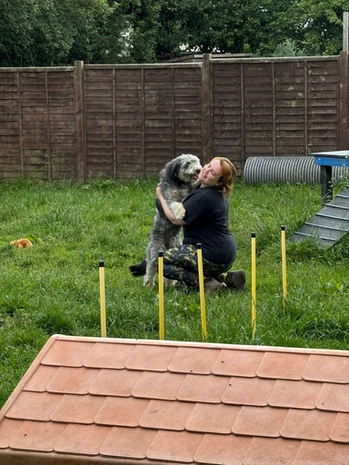
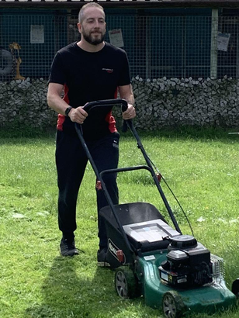
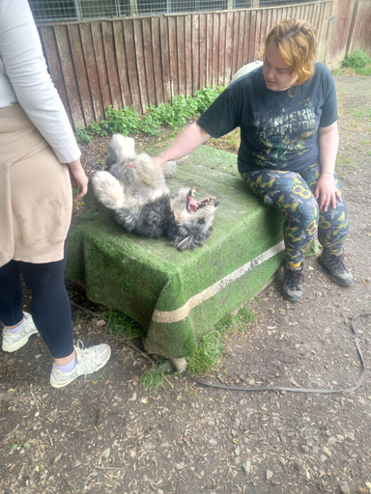
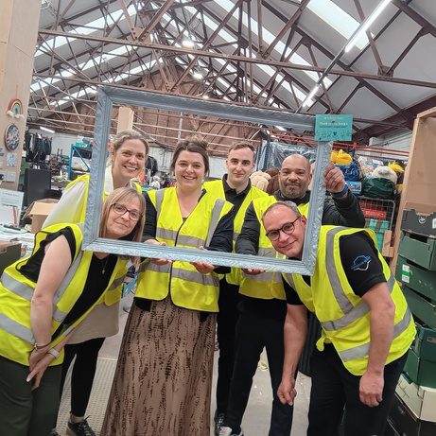

VOLUNTEERING
09
WE VOLUNTEERED OVER 200 HOURS IN 2024 ACROSS SEVERAL ORGANISATIONS

Slide 12
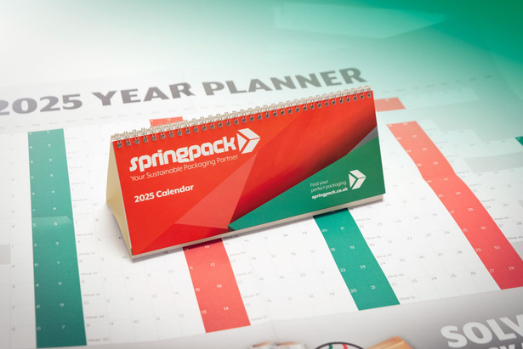
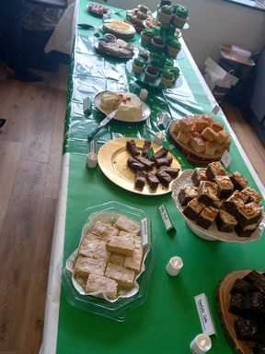
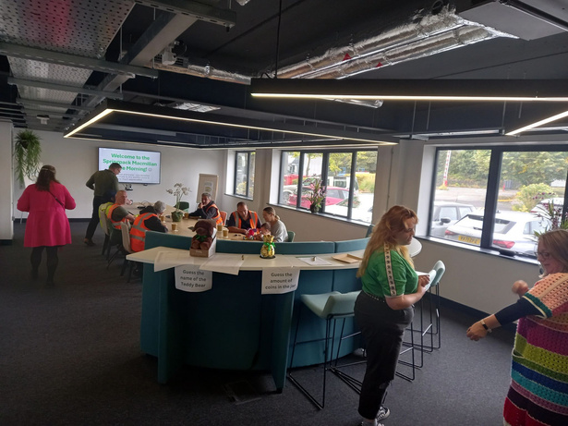
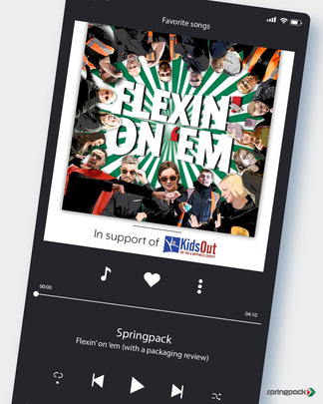
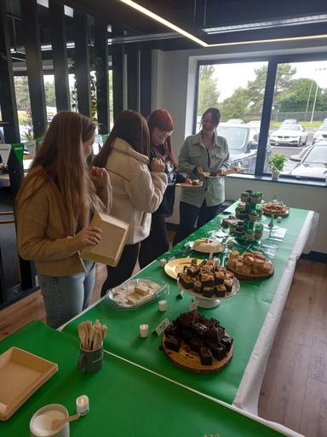
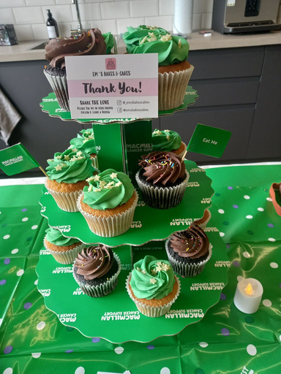
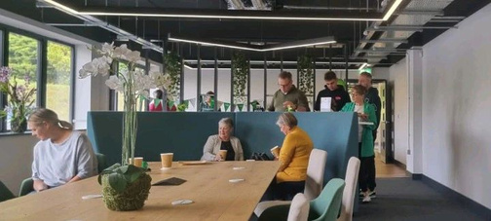
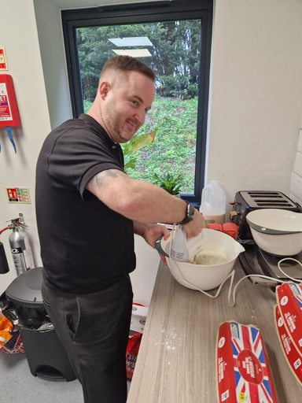
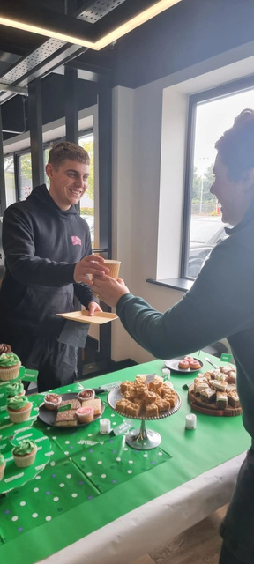
10
PANCAKE DAY, MACMILLAN COFFEE MORNINGS, PRINTED CALENDARS WITH EACH MONTH HOLDING A NEW CHARITY THROUGH TO OUR FIRST EVER CHARITY SINGLE.
OVER £500 RAISED
CHARI
Y

Slide 13







ACCREDITATIONS
11

Slide 14


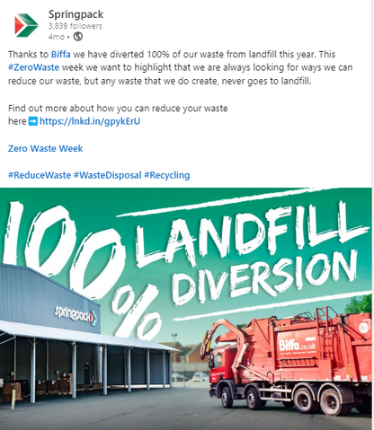
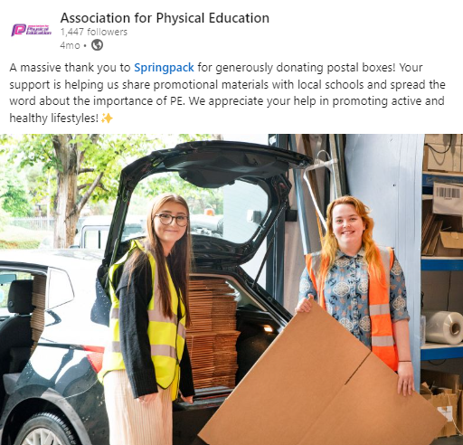
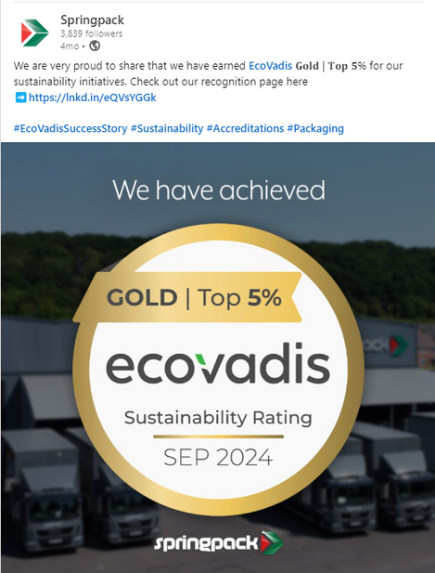
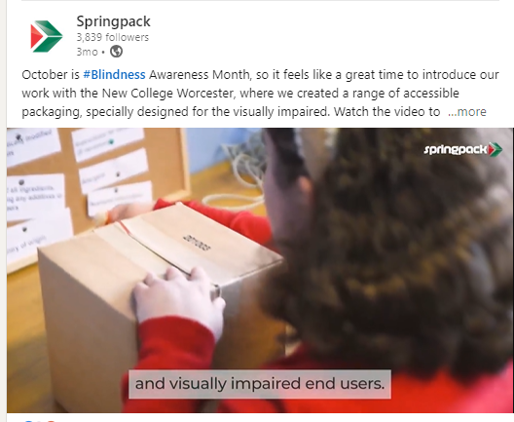
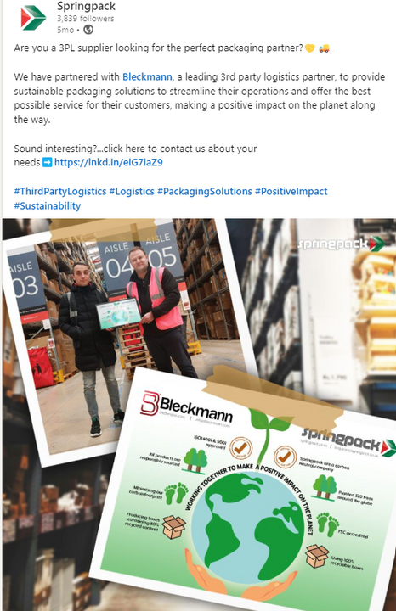
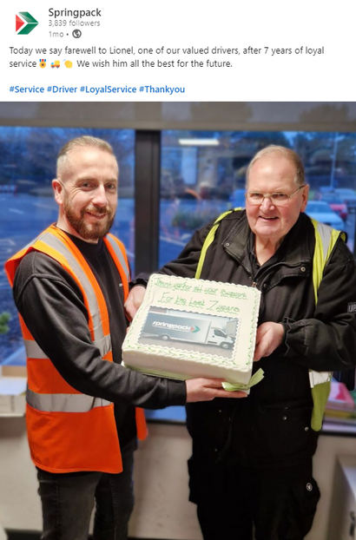
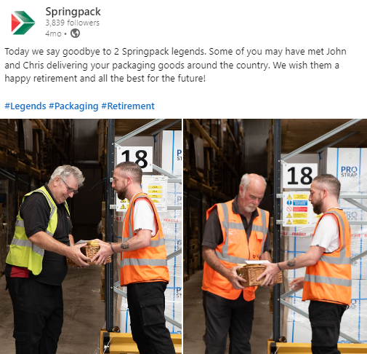
SOCIAL
12

Slide 15







THE FUTURE VISION
13
RETAIN OUR CARBON NEUTRAL STATUS
50% INCREASE IN ELECTRIC CAR FLEET
INCREASE EMPLOYEE WELLBEING HOURS
INCREASE RECYCLED CONTENT ACROSS PRODUCTS
20% REDUCTION IN ENERGY USAGE
RETAIN
ECOVADIS GOLD

Slide 16











THANK YOU
01905 457000
www.springpack.co.uk
enquiries@springpack.co.uk
Woodside Point, Worcester,WR5 1SG

